Slide 1

DUBIOUS ACTIVITY DETECTION
DEVELOPED BY :
ROSHID A.V
RAHUL RAJAN
CHRISTY GEORGE THOMAS
ABHISHEK HARY

Slide 2
WHAT WE DISCUSS TODAY
PREFACE
MODEL STUDY
WORKING DESIGN
OPERATION
SAMPLE CODE AND OUTPUT
CONCLUSION AND FUTURE SCOPE

Slide 3
PREFACE
Video surveillance is an ever growing field in todays world.
Security breaches and attacks on human lives are increasing on a day-to-day basis.
CCTV cameras and security sensors are more prevalent now than before.
A proper surveillance system can prevent such dubious activities up to an extent.
In this initiative we aim to analyze a video footage and examine whether there occurs a dubious activity or not.

Slide 4
MODEL STUDY
We aim to build a sufficiently working model to receive a video footage and classify the feed in to safe, potentially dubious or dubious(criminal activity).
Convolutional Neural Network and Feed Forward Neural Network is used to build the model.

Slide 5
Feed forward neural networks(multilayer perceptrons) are the quintessential deep learning models.
The goal of a feedforward network is to approximate some function f.
For example, for a classiﬁer, y = f(x) maps an input x to a category y. A feedforward network deﬁnes a mapping y = f(x;θ) and learns the value of the parameters θ that result in the best function approximation.
These are called feedforward because information ﬂows through the function being evaluated from x, through the intermediate computations used to deﬁne f, and ﬁnally to the output y.

Slide 6
A Convolutional Neural Network (CNN) is a Deep Learning algorithm which can take in an input image, assign importance (learnable weights and biases) to various aspects/objects in the image and be able to differentiate one from the other.

Slide 7
WORKING DESIGN
Collecting the video files and converting it into frames.
Preprocessing the data.
Building the model.
Compiling the model.
Training the model.
Testing the model.

Slide 8



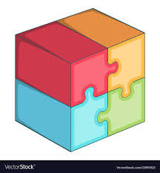
DATA PREPROCESSING
TRAINING VIDEO
MODEL BUILDING USING CNN
MODEL INPUT DATA
DUBIOUS
POTENTIALLY
DATA PREPROCESSING
SAFE
NEW INPUT VIDEO

Slide 9
OPERATION
Training video is converted into frames.
Classifying the frames into three categories( safe, potentially dubious, dubious).
Split the data to test and train.
Build the model using pre trained CNN model of keras(VGG16).
Apply this on Feed Forward Network having a hidden layer with 1024 neurons and an output layer with 3 neurons(since we have 3 classes to predict).
Testing the model with test data and finding out the accuracy.
A new video is fed as the input and is classified to either of these three categories.

Slide 10
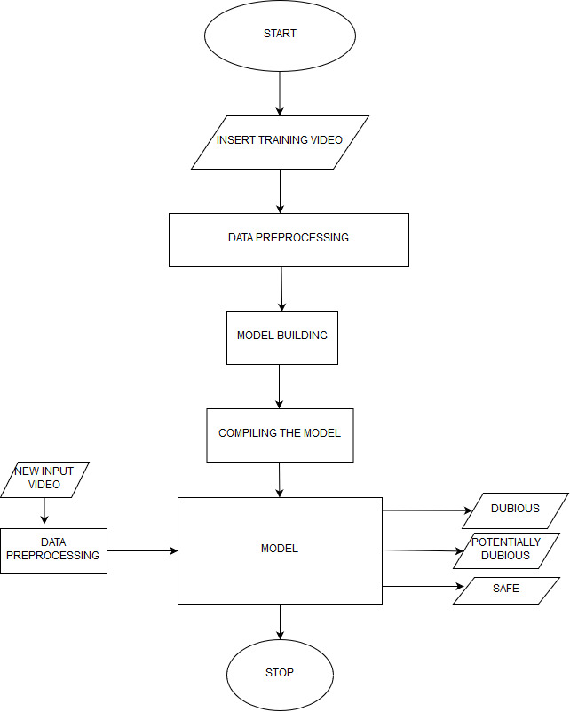
FLOW CHART

Slide 11

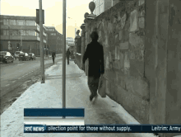
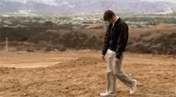
EXPECTED OUTPUT
DUBIOUS
POTENTIALLY DUBIOUS
MODEL
SAFE

Slide 12
VGG16 – Pre trained CNN model
VGG16 is a convolutional neural network model proposed by K. Simonyan and A. Zisserman from the University of Oxford in the paper “Very Deep Convolutional Networks for Large-Scale Image Recognition”.
The model achieves 92.7% top-5 test accuracy in ImageNet, which is a dataset of over 14 million images belonging to 1000 classes.

Slide 13
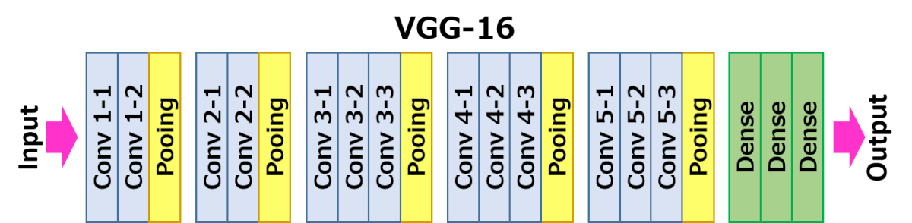

Slide 14


Slide 15
The objective of maxpooling is to down-sample an input representation (image, hidden-layer output matrix, etc.), reducing its dimensionality.
ReLU is the most commonly used activation function in neural networks, especially in CNNs.
ReLU stands for rectified linear unit function. Mathematically, it is defined as y = max(0, x).
ReLU is linear (identity) for all positive values, and zero for all negative values.
SoftMax is often used in neural networks, to map the non-normalized output of a network to a probability distribution over predicted output classes.
The SoftMax is often used in the final layer of a neural network-based classifier.

Slide 16
Libraries used:
Numpy
Pandas
Matplotlib
Keras
Skimage
OpenCV

Slide 17
SAMPLE CODE
DATA PREPROCESSING
for img_name in data.Image_ID:
img = plt.imread('image/' + img_name+'.jpg')
X.append(img) # storing each image in array X
X = np.array(X) # converting list to array
y = data.classes
dummy_y = np_utils.to_categorical(y) # one hot encoding Classes

Slide 18
for i in range(0,X.shape[0]):
a = resize(X[i], preserve_range=True, output_shape=(224,224)).astype(int) # reshaping to 224*224*3
image.append(a)
X = np.array(image)
from keras.applications.vgg16 import preprocess_input
X = preprocess_input(X, mode='tf') # preprocessing the input data

Slide 19
MODEL CREATION
from keras.models import Sequential
from keras.applications.vgg16 import VGG16
from keras.layers import Dense, InputLayer, Dropout
base_model = VGG16(weights='imagenet', include_top=False, input_shape=(224, 224, 3)) # include_top=False to remove the top layer
X_train = base_model.predict(X_train)
X_valid = base_model.predict(X_valid)
X_train = X_train.reshape(733, 7*7*512) # converting to 1-D
X_valid = X_valid.reshape(315, 7*7*512)
train = X_train/X_train.max() # centering the data
X_valid = X_valid/X_train.max()

Slide 20
# i. Building the model
model = Sequential()
model.add(InputLayer((7*7*512,))) # input layer
model.add(Dense(units=1024, activation='sigmoid')) # hidden layer
model.add(Dense(3, activation='softmax')) # output layer
model.summary()
#ii. Compiling the model
model.compile(loss='categorical_crossentropy', optimizer='adam', metrics=['accuracy'])

Slide 21
TRAINING THE MODEL WITH FEED
iii. Training the model
model.fit(train, y_train, epochs=10, validation_data=(X_valid, y_valid))
y_pred = model.predict(X_valid)
from sklearn.metrics import confusion_matrix
confusion = confusion_matrix(np.argmax(y_valid,axis=1), np.argmax(y_pred,axis=1))
print(confusion)

Slide 22
TESTING THE MODEL WITH NEW FEED
# preprocessing the images
test_image = preprocess_input(test_image, mode='tf')
# extracting features from the images using pretrained model
test_image = base_model.predict(test_image)
# converting the images to 1-D form
test_image = test_image.reshape(rt, 7*7*512)
# zero centered images
test_image = test_image/test_image.max()
predictions = model.predict_classes(test_image)

Slide 23
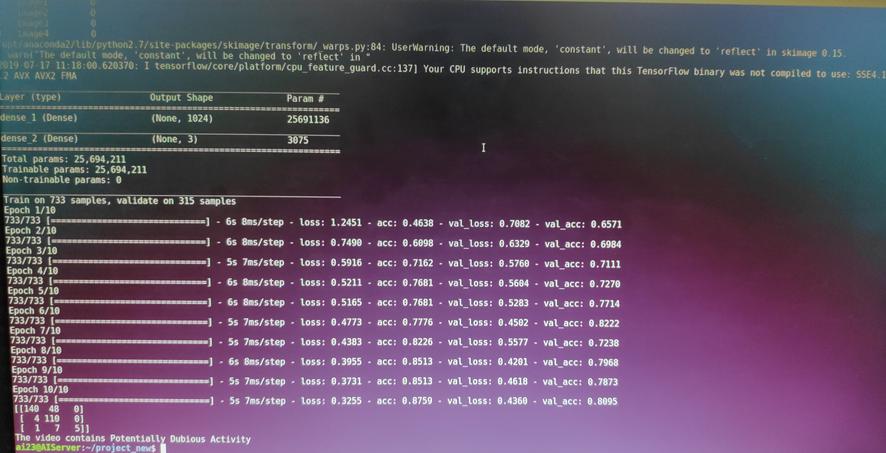
SAMPLE OUTPUT

Slide 24
CONCLUSION & FUTURE SCOPE
We aimed at developing a model which will analyze a video footage and finds out the presence of a harmful activity in the same
One of the things that we can do with this video classifier is to connect it to a security camera and keep analyzing the video in real-time, and the moment the system detects criminal or suspicious activity, it could activate an alarm or alert the police.
Furthermore, you can use a similar system trained with the appropriate data to detect different kinds of activities; for example, with a camera located in a school where your objective could be to detect bullying.
We can use the system to analyze saved footages and detect the presence of any illegal activities.

Slide 25


Slide 26


